Slide 1
Determining and Modeling Hazardous Near Earth Objects
By: Dwayne Bost, Jared Klein, and Michael Ebanks

Slide 2
What Are Near Earth Objects?
According to NASA, a NEO (Near Earth Object) is “are comets and asteroids that have been nudged by the gravitational attraction of nearby planets into orbits that allow them to enter the Earth’s neighborhood.”
Put simply, they are objects in our solar system that are “near” Earth.
These NEOs become hazardous and a potential danger to Earth when they come within Earth’s MOID (Minimum Orbit Insertion Distance).
NASA specifies that “all asteroids with an Earth Minimum Orbit Intersection Distance (MOID) of 0.05 au or less and an absolute magnitude (H) of 22.0 or less are considered PHAs.”
Source: https://cneos.jpl.nasa.gov/about/basics.html

Slide 3
Who Really Cares? What is the Value of this study?
Governments, scientists, and students alike all value data on NEO’s for various reasons. The latter two audiences like to talk about finding answers about the behavior of celestial objects and the origins of the cosmos. However, the former audience, governments, have interests that more align with the defense of the planet.
It is true that the likelihood of Earth being hit by a NEO which could harm our planet is incredibly low (NASA’s Planetary Defense Coordination Office claims that it is less that 0.2 percent ). Nevertheless, governments around the world still worry about the threat of NEOs.
Why?

Slide 4
Here’s Why…
Verdefort Crater, South Africa
Sudbury Basin, Ontario, Canada
These physical features on Earth’s surface are believed to have been caused by NEOs colliding with the Earth’s surface. Some of these collisions are theorized to have changed life on Earth as we know it. Remember the Dinosaur theory?
Illustration of Chicxulub impact crater in the Yucatán Peninsula
Source: https://news.nationalgeographic.com/news/2013/13/130214-biggest-asteroid-impacts-meteorites-space-2012da14/

Slide 5
Motivation & Summary of Findings
Motivation for taking on this project stems from a desire to improve our elementary knowledge of Asteroids, and assess what makes a NEO hazardous.
Summary of our findings:

Slide 6
Questions We Asked And the Data We Needed
Questions we asked:
What data is used to classify a NEO as hazardous?
How do we model and visualize hazardous NEOs?
How can we anticipate and determine NEO hazards?
Our Goals with this project:
Examine the characteristics of the asteroid related to its classification as hazardous.
Model the orbital movements of NEOs closest to and relative to the Earth.
Examine past impacts of Asteroids on Earth.
The data we used:
NASA’s NeoWs open API which provided information on thousands of Asteroids.
Included data such as: the asteroid name, its relative velocity of the asteroid, it’s close approach date to Earth, and it’s absolute magnitude.
We also included data from NASA’s Fireball csv files that included data on locations of impacts.

Slide 7
Data Cleanup & Exploration
Methods and Insights we did not anticipate:
Methods:
Cleaned and saved data into csv’s using jupyter notebook.
Used modules such as: pandas, matplotlib, astropy, and poliastro. The latter two were for orbital visualization.
Surprising Insights:
Terminology to determine what is a hazardous object, and the sheer number of hazardous objects that routinely pass by Earth.
According to Kepler’s secondary law of planetary motion, “the speed of an object in its orbit is fastest at perihelion and slowest at aphelion.” Perihelion being the closest point of an object orbiting the sun, and aphelion being the opposite. This applies to asteroids as well, and their relative velocities.
Problems:
We had difficulty indexing the NASA JSON. We had to run several ”for” loops in order to retrieve the information we needed.
Given the volume of the NASA API (i.e.. NEO having multiple approach dates), parsing the JSON request was difficult.
Needed to use multiple different url’s to query different NEO information (i.e.. NEOs info organized by dates as opposed to the whole database).
Had difficulty propagating EPOCHS, or specific points in time, for individual asteroids to create a reliable orbit visualization.
Our elementary understanding of NEO’s and the science meant that we had to do significant research in order to determine what data we needed. (i.e.. MOID, EPOCH, Perihelion Distance, Perihelion Argument etc.
Source: https://www.windows2universe.org/physical_science/physics/mechanics/orbit/perihelion_aphelion.html&edu=high

Slide 8

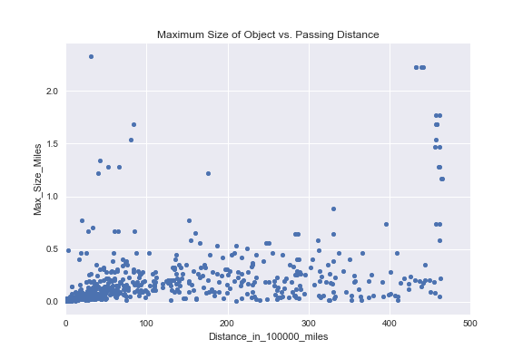
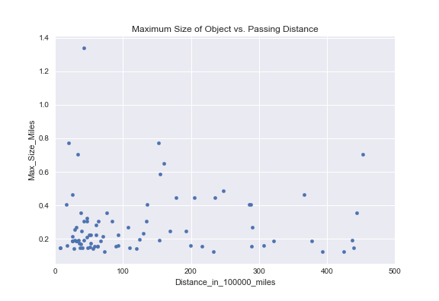
Data Analysis: There are A ton of Asteroids
This is just a small subset of 500 NEOs for representation purposes reflecting size vs. passing distance. Shown to visualize just how many objects there are to study.
Hazardous NeOs
Now that we have the given data size of NEOs, we now need to ask how many of those are hazardous?
That’s what this visualization is for. We’ve essentially filtered the previous graph for just those that are determined to be hazardous.
By doing this exercise, we’ve now been able to visualize our dataset, and we’ve filtered for our NEOs in question.

Slide 9
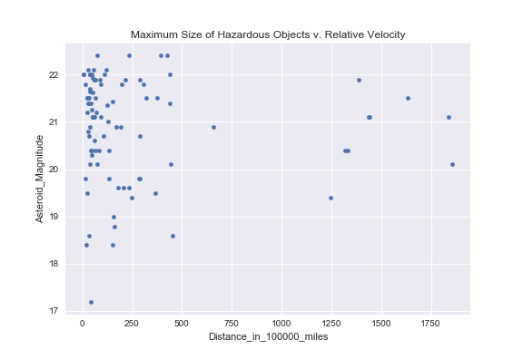
Data Analysis: Determining which Neos are Hazardous.
This scatter plot is a visualization of the definition of a hazardous NEO.
Recall the earlier slides, where a hazardous NEO is classified by the relationship between its absolute magnitude(H) and its MOID (distance from Earth < .05 astronomical units or around 4.6 million miles).
For context, magnitude is used to estimate the diameter of the Asteroid which helps determine its size. Thus, assists in its classification as hazardous (equation below).
This establishes that there is a relationship between the size and distance from of a NEO from Earth which leads to its classification.

Slide 10
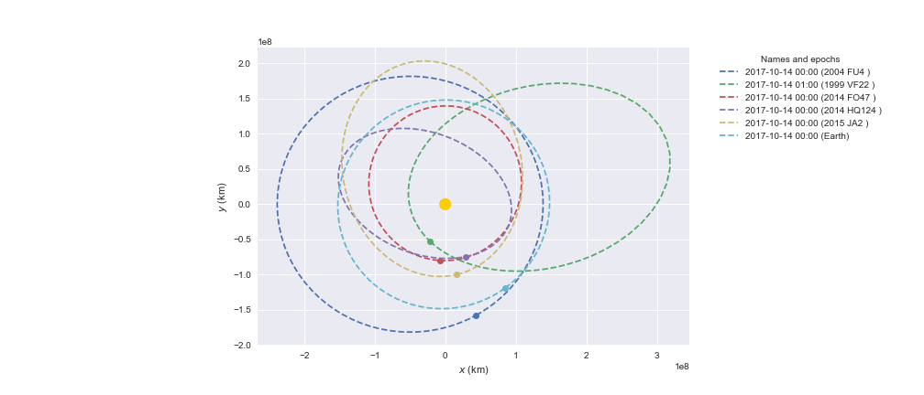
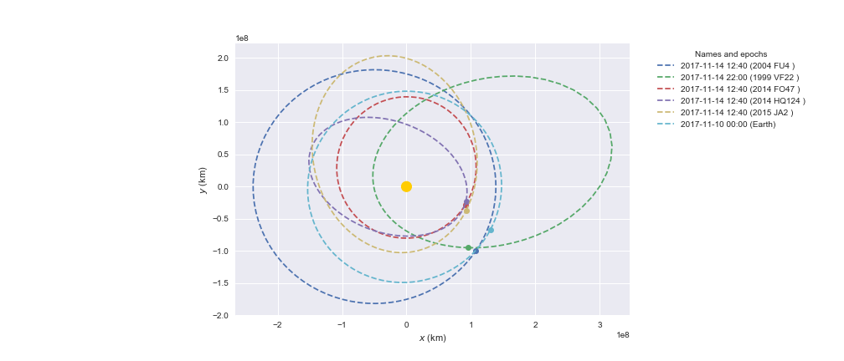

Slide 11
Post Mortem

Slide 12
Questions?

